Slide 1
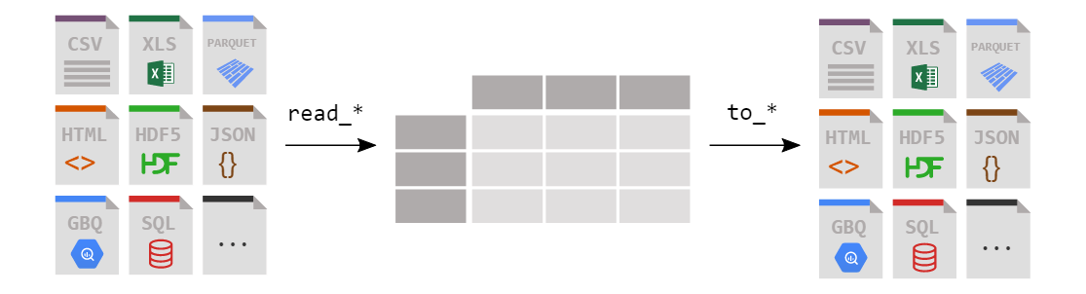
Loading DataFrame from files

Slide 2
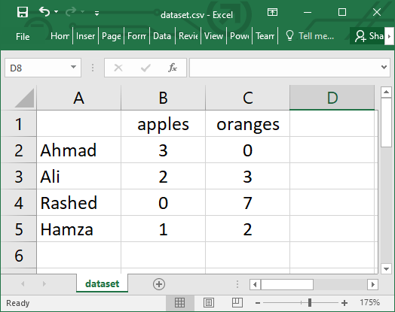
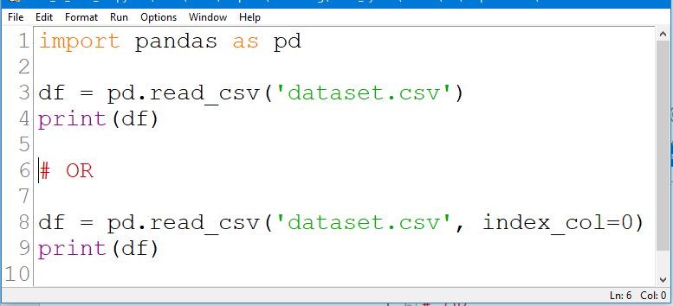
Reading data from a CSV file

Slide 3
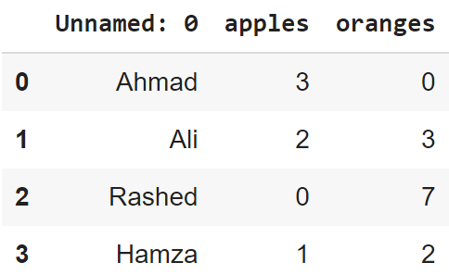
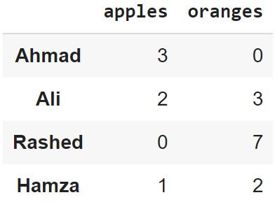
Reading data from CSVs
With CSV files, all you need is a single line to load in the data:
df = pd.read_csv('dataset.csv')
CSVs don't have indexes like DataFrames, so all we need to do is just designate the index_col when reading:
df = pd.read_csv('dataset.csv', index_col=0)
Note: here we're setting the index to be column zero.

Slide 4
Reading Data from CSV
To load dataset from a CSV file named loans and designating the column loan references to be our index.
df=pd.read_csv(“loans.csv", index_col="Loan Reference")

Slide 5
Viewing your data
The first thing to do when opening a new dataset is print out a few rows to keep as a visual reference. We accomplish this with .head():
.head() outputs the first five rows of your DataFrame by default, but we could also pass a number as well: df.head(10) would output the top ten rows, for example.
To see the last five rows use .tail() that also accepts a number, and in this case we printing the bottom two rows.:
df.head()
df.head(10)
df.tail(2)

Slide 6
Viewing your data
Return a single column of Data
print(df['LoanProductName'].to_string(index=False)) return column with no column label
df[‘apples']

Slide 7
Converting back to a CSV or other formats
After working or cleaning your data in the file, you may want to save it as a file of your choice. pandas provides commands to save. For example to save as a CSV you do the following
df.to_csv('new_dataset.csv') et', con)

Slide 8
Data Cleaning
When working with datasets, there are chances that your data may be incorrect, duplicated, or mislabeled. If data is wrong, outcomes and algorithms are unreliable, even though they may look correct. Data cleaning is the process of fixing bad data in your dataset.
The Bad data could be:
Empty cells
Data in wrong format
Wrong data
Duplicates

Slide 9
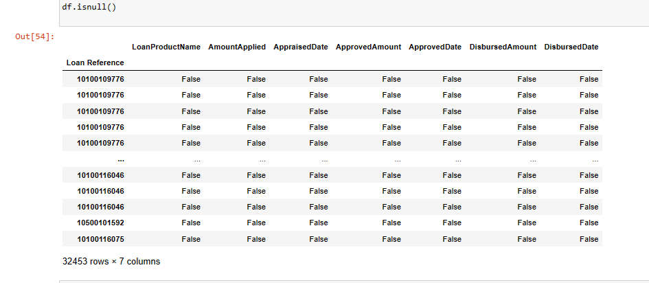
Rebuild Missing Data in DataFrame
To find missing Data in dataset we can use the following methods
isnull() function: This function provides the boolean value for the complete dataset to know if any null value is present or not.

Slide 10
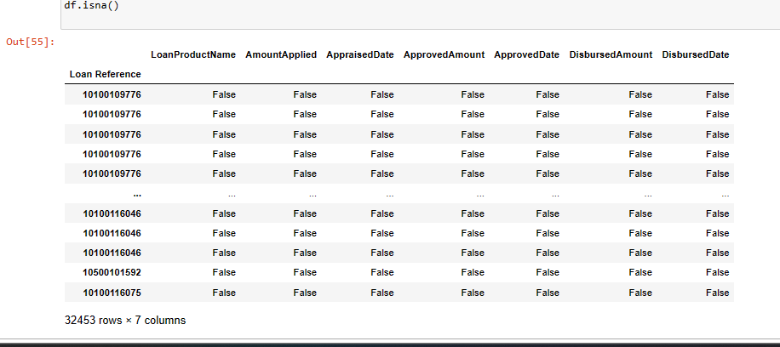
Rebuild Missing Data in DataFrame
To find missing Data in dataset we can use the following methods
2. isna() function : This function provides the boolean value for the complete dataset to know if any null value is present or not.

Slide 11
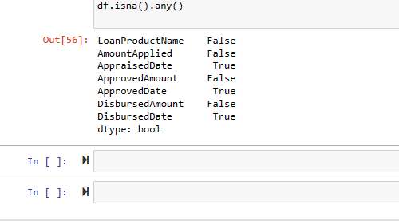
Rebuild Missing Data in DataFrame
To find missing Data in dataset we can use the following methods
3. Using isna().any() function : This function also gives a boolean value if any null value is present or not, but it gives results column-wise, not in tabular format.

Slide 12
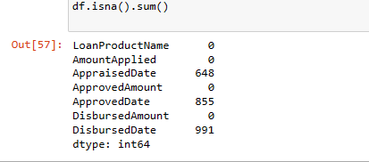
Rebuild Missing Data in DataFrame
To find missing Data in dataset we can use the following methods
4. Using isna(). sum() function : This function gives the sum of the null values present in the dataset column-wise.

Slide 13
Removing empty cells
To remove empty cells we drop the rows with empty cells
To drop the rows we use the function dropna()
new_df = df.dropna()
By default, the dropna() method returns a new DataFrame, and will not change the original.
If you want to change the original DataFrame, use the inplace = True argument
df.dropna(inplace = True)

Slide 14
Rebuild Missing Data in DataFrame
To fill the null values we use the fillna() method
This method replaces the NULL values with a specified value
General Syntax: dataframe.fillna(value, method, axis, inplace, limit, downcast)

Slide 15

Rebuild Missing Data in DataFrame
Value- this is the required, Specifies the value to replace the NULL values with
inplace – this is an optional Boolean parameter, the default is False. If True: the replacing is done on the current DataFrame. If False: returns a copy where the replacing is done.
Limit- this is an optional parameter, default is None. Specifies the maximum number of NULL values to fill (if method is specified)
Method-is an optional parameter, default None. Specifies the method to use when replacing such as bfill,ffil,pad, none etc.
Axis- Optional parameter, default 0. The axis to fill the NULL values along
Downcast- optional parameter, Convert filled values to a specific dtype. Either Dictionary or a string

Slide 16
Example
import pandas as pd
import numpy as np
# Creating a sample DataFrame
df = pd.DataFrame({
'A': [1, np.nan, 3, np.nan],
'B': [4, 5, np.nan, 7]
})
print(df)
# Fill NaNs with a specific value
df_filled = df.fillna(0)
print(df_filled)
# Fill NaNs using forward fill method
df_filled_ffill = df.fillna(method='ffill')
print(df_filled_ffill)
# Fill NaNs along columns with a limit of 1
df_filled_limit = df.fillna(method='bfill', limit=1)
print(df_filled_limit)

Slide 17
Rebuild Missing Data in DataFrame
Fill all nulls with a specified value
newdf = df.fillna(10) all nulls are filled with 10
df.fillna(130, inplace = True)
This will not create a new dataframe because of the inplace parameter

Slide 18
Rebuild Missing Data in DataFrame
Replace Only For Specified Columns
df[“ProductName"].fillna(10, inplace = True)

Slide 19
Rebuild Missing Data in DataFrame: ffill() Method
ffill() Method
This method is used to replace NULL values with the value from the previous row (or previous column, if the axis parameter is set to 'columns').
newdf = df.ffill()
General syntax is dataframe.ffill(axis, inplace, limit, downcast)
All parameters are optional

Slide 20
Rebuild Missing Data in DataFrame fill with Mean, Median, or Mode
Replace Using Mean, Median, or Mode
mn = df[“AmountApplied"].mean() df["AmountApplied"].fillna(mn, inplace = True)
OR
mn = df[“AmountApplied"].median()
df["AmountApplied"].fillna(mn, inplace = True)
OR
mn = df[“AmountApplied"].mode()[0]
df["AmountApplied"].fillna(mn, inplace = True)

Slide 21

Rebuild Missing Data in DataFrame: ffill() Method
For given column such as the amount applied in our dataset
df[“AmountApplied"].fillna( method ='ffill', limit = 1, inplace = True)
This will only fill a single null with the previous row value incase of 2 or more consecutive nulls occurrence

Slide 22
Handling Duplicates
To discover duplicates, we can use the duplicated() method. The method Returns True for every row that is a duplicate, othwerwise False.
print(df.duplicated())
We can drop all the duplicates as follows
df_dup=df_dup.drop_duplicates(), or df_dup.drop_duplicates(inplace = True)
print(df_dup.shape)

Slide 23
Data of wrong Formats
When we have data of the wrong format we can
Remove the rows,
Convert all cells in the columns into the same format.
Convert to correct format
For example cells with wrong date format can be corrected using to_datetime() method
df[‘DisburmentDate'] = pd.to_datetime(df[' DisburmentDate']) print(df.to_string())

Slide 24
Data of wrong Formats: Removing Rows
After the conversion above, where the date was null or connerted to NAT(Null) we can drop the rows
df.dropna(subset=[‘DisburmentDate'], inplace = True)

Slide 25
Removing Wrong Data
Data in the dataset can be wrong, for example a wrong value in the dataset caused by typos
One way to resolve this problem is to replace them with correct values
df.loc[7, ’AmountDisbursed'] = 100000
To replace wrong data for larger data sets you can can use rules. You can such for illegal values with set boundaries
For example if If the value is lower than certain value x, you set it equal to x
for x in df.index: if df.loc[x, “AmountDisbursed"] <0: df.loc[x, " AmountDisbursed "] = 0

Slide 26
Removing Wrong Data
You can also drop rows with the wrong data
for x in df.index: if df.loc[x, “AmountDisbursed"] <0: df.drop(x, inplace = True)

Slide 27
Pop() function
DataFrame.pop() method drops the specified item in the DataFrame and returns the specified item. We can use this method to delete any element from the dataframe.
print(df.pop("AmoutApplied")) this drops the amount applied column
Another method for dropping a column is drop()
df.drop([‘columnname'], axis=1) this method drops but does not return the data
You can drop more than 1 column with this method: syntax df.drop(['column1', 'column2'], axis=1)

